Slide 1





AGRICULTURE VALUE CHAIN PROJECT (AVCP)
EXIT MEETING FOR BUIKWE DISTRICT
VENUE: DISTRICT HEADQUARTERS
DATE: 15th February 2024

Slide 2

Introduction
GoU received a loan from African Development Bank (ADB) for commercialization of agriculture among SHFs
Aim: Improving livelihoods among SHFs with focus of Maize & Rice value chains
Major objective: Improve household incomes, food security and climate resilience through commercial agricultural practices, sustainable natural resources management & agricultural enterprise development
The Consortium of IIRR & APSEDEC was contracted to implement the project in 15 districts

Slide 3
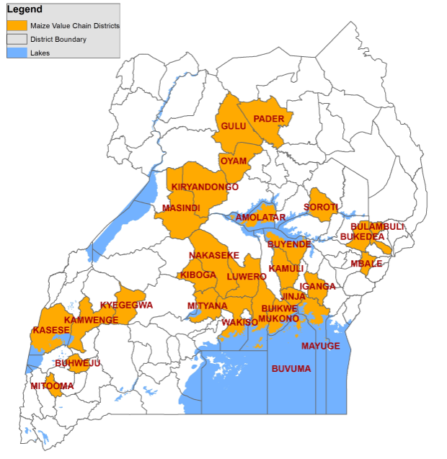
Operation areas
Source: MAAIF 2023
For central region implementation was in Buikwe, Buvuma, Kiboga, Mukono, Nakaseke, Luwero, Mityana and Wakiso

Slide 4
Summary of activities & achievements
No. | Activity | Target | Achievement
1 | District inception report compilation | 1 report | Report on the geography of the operational area, demographic figures and stakeholders existing in the areas was submitted
2 | District entry meetings | 1 meeting | Meeting held with District Local Government (DLG) officials
3 | Recruitment and training of staff | 5 | 5 recruited with support of the DPO and trained
4 | Inception meeting | 1 meeting | Meeting held at the district on 25th February 2022
5 | Farmer group identification, mobilization and registration | 936 Groups | 941 Groups ( FGs and / VSLAS) Supported. These had a total membership of 18,677 with 7,881 Males and 10,796 females

Slide 5
Summary of activities & achievements
No. | Activity | Target | Achievement
6 | Capacity Needs assessment | 1 assessment conducted | Assessment conducted and results indicated the highest-ranking training needs as postharvest handling, cross cutting issues, application of improved technologies like fertilizers, record keeping and Climate resilience approaches etc
7 | Trainings in different deliverables | 52842 sessions | 53170 session conducted in FID, GAP, PHH, LSB, VAM, VSLA, CCI, FAAB, Group marketing etc
8 | Mapping of value actors, training them and linking them to farmers | 18 18 83 18 | 11 input dealers in the district plus Brac NASECO, Okeba Seeds 13 processors/ millers 94 Village Agents 37 Traders or offtakers in the district plus Grain pulse and Agroways

Slide 6
Summary of activities & achievements
No. | Activity | Achievement
10 | Linkages to Financial Institutions | DFCU, Stanbic, Opportunity Bank - Bank accounts opened - Loans acquired
11 | Linkages to insurance companies | MUA - Farmers paid for insurance
12 | Distribution of input | Seed, fertilizer and pesticides for 3 seasons
13 | Setting up of demos | -demos set up during the two years

Slide 7
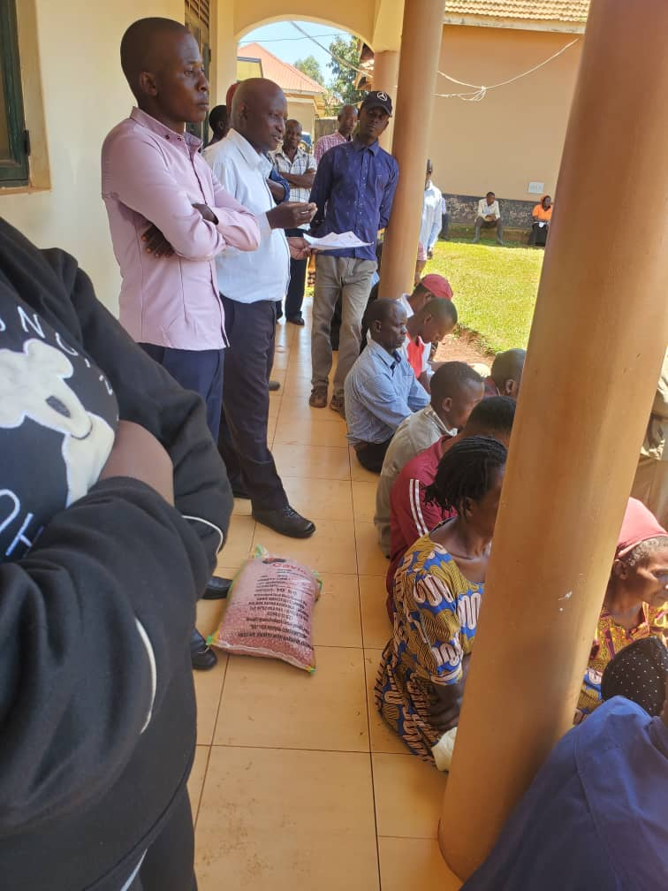
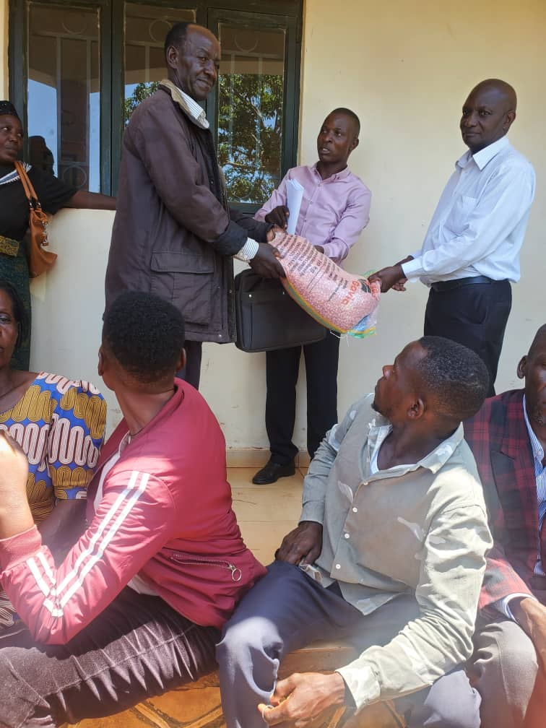

Slide 8
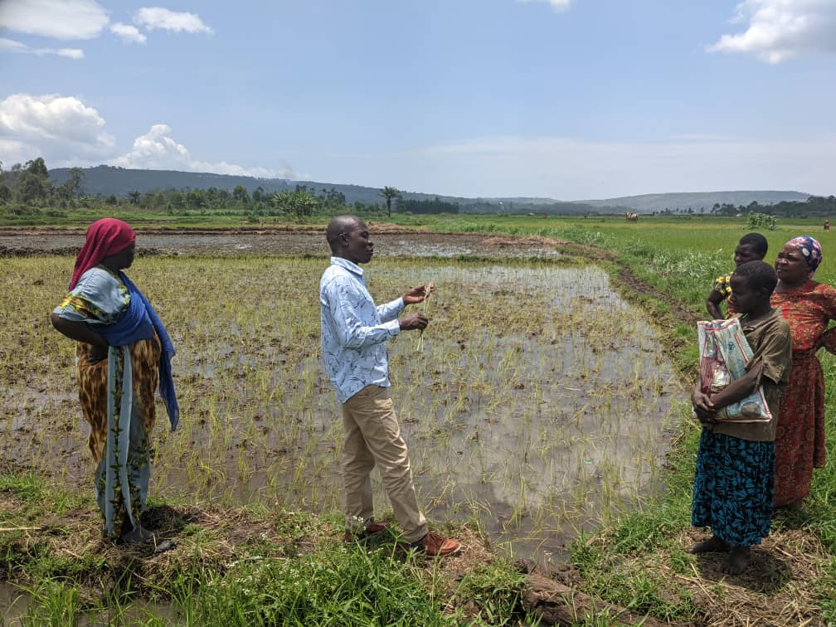
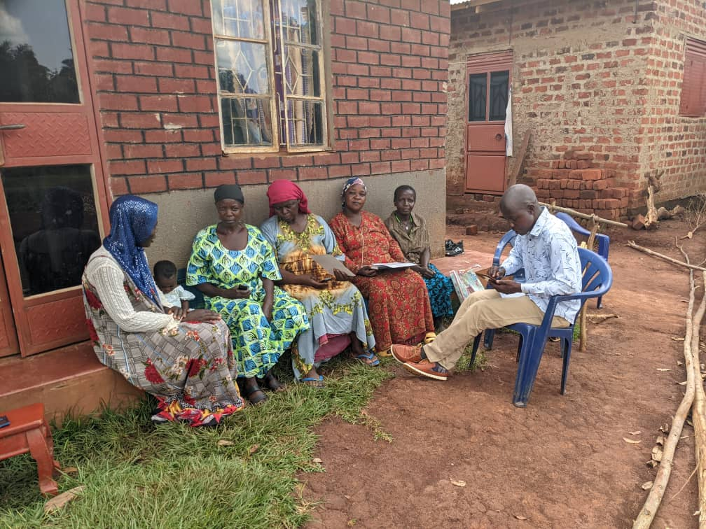

Slide 9
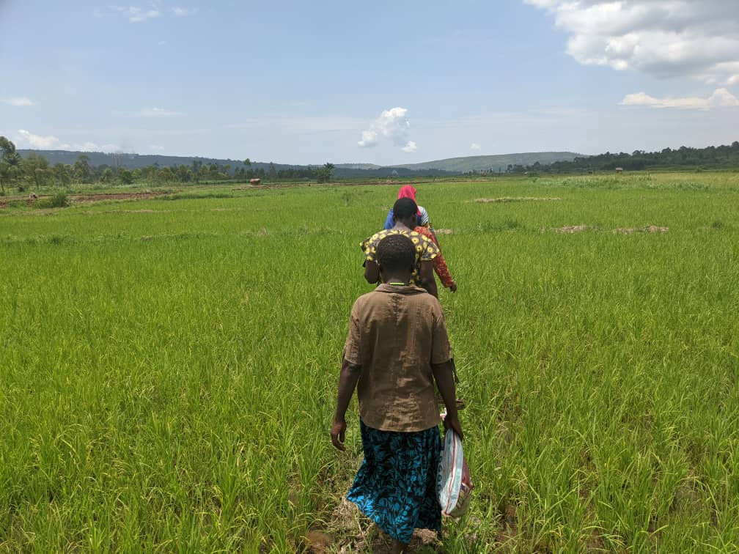

Slide 10
General outcomes
Stakeholders understanding of the project
Increased production and productivity
Improved access to VC support services
Improved access to finance
Increased sales volumes
Improved incomes
Improved employment along the value chain nodes
Improved adoption and technology access

Slide 11
General Challenges
Late delivery of Agro Inputs
Delivery of poor-quality seed
Fluctuating fuel prices
Delayed release of funds
Unpredictable weather

Slide 12
Thank you for listening

